Slide 1
SOURCE CODE MANAGEMENT
FOODCHAIN
GUARDIAN
Smart Food Spoilage Monitoring System
Why Foodchain Guardian: spoilage caught by a manual check is spoilage caught too late, this system flags the risk while there's still time to act.
TEAM —
Shreyas VS • Yashvi • Jai Aditya P • Akshara • Jaysukh

Slide 2
WHY THIS MATTERS
The cold chain breaks quietly — and by the time anyone notices, it's too late.
OUR ANSWER
1
Massive Food Waste
Poor temperature control during storage and transport spoils food that could have been saved.
Shift from reactive checks to proactive detection — predict spoilage risk before food actually spoils.
2
Health & Safety Risk
Undetected spoilage that reaches consumers creates real foodborne-illness risk.
Continuously simulated sensor data, per food item
3
Manual Checks Fail
Automated Safe / Medium / High risk classification
Real-world example: milk sitting in high heat during transport degrades quickly — but traditional spot-checks only catch it after it has already spoiled.
Instant email + SMS alerts when risk turns High
4
No Early Warning
Without continuous monitoring, teams find out about a problem only once it's unrecoverable.
A software-based cold-chain monitor that tracks temperature, humidity, and time elapsed — continuously, automatically.
5
Compliance & Traceability Gaps
Auditors and regulators need accurate, time-stamped records — something manual paper logs rarely provide reliably.
2

Slide 3
WHAT IS FOODCHAIN GUARDIAN?
FoodChain Guardian is a software-based cold-chain monitoring system — no extra hardware required. It continuously tracks environmental conditions per food item and calculates a live spoilage-risk level, so problems are caught before they become waste.
SYSTEM FLOW
By continuously comparing live readings against safety thresholds, it flags problems in real time instead of relying on periodic manual checks — turning food safety from a guessing game into a monitored process.
1
Sensor Simulation
Generates realistic temp / humidity data per food type
▾
Built entirely in JavaScript, on Node.js + Express.js
Risk Engine
2
Rule-based classification: Safe / Medium / High
Delivered through a disciplined Git / GitHub workflow — feature branches, pull requests, code review
▾
3
Database
SQLite persists readings, results, alerts, logs
SUMMARY
A simulated fridge holding chicken drifts to 9°C. FoodChain Guardian catches it, classifies it High Risk, logs it, and fires an alert — all before a human ever checks the thermometer.
▾
4
Dashboard
Live status, history & alerts, in the browser
3

Slide 4
WHAT IT DOES
1
Simulate
2
Classify
Generates realistic temperature & humidity data streams per food type, including injected abnormal spikes and drops.
Rule-based risk engine scores each reading against temperature, humidity, storage time & food-specific thresholds aligned with USDA / FSSAI guidance.
e.g. a simulated fridge holding chicken drifts from 4°C to 9°C overnight.
e.g. that same reading is instantly classified High Risk.
3
Store & Log
4
Alert
SQLite persists every reading, risk verdict, alert, and activity-log entry for full traceability.
Fires automatic email + SMS notifications the moment a High-risk condition is detected — with duplicate-alert prevention.
e.g. every verdict is timestamped, so nothing is lost after the fact.
e.g. the team is notified before the batch would otherwise be lost.
Together, these four capabilities form one continuous pipeline — from a raw sensor reading to an actionable alert.
4

Slide 5
TECH STACK & COLLABORATION WORKFLOW
Every module runs on the same stack, coded together in VS Code — and every merge follows the same review discipline.
TECH STACK
WORKFLOW
1
Node.js + Express.js
Dedicated feature branch per member — feature/sensor, feature/risk-engine, feature/dashboard, feature/alerts-db
Core application language & API layer
2
SQLite
25+ meaningful commits per member — 100+ total across the team
Stores historical logs, alerts & food profiles
3
HTML / CSS / JavaScript
Interactive front-end dashboard
Pull requests + code review required before merging into main
4
Git & GitHub
Feature-branch workflow for all 5 members
Clean, modular folder structure — sensor_sim/, risk_engine/, dashboard/, alerts_db/
5
Visual Studio Code
Shared editor for the whole team — consistent linting, formatting & extensions
5

Slide 6
SHREYAS VS
Risk Calculation Engine
1
Developed the rule-based food spoilage risk calculation engine.
1
SHREYAS VS
Uses temperature, humidity, storage time & food type as inputs, with validation for invalid values.
2
Risk Calculation Engine
Defines food-specific conditions and thresholds for accurate risk calculation.
3
Generates risk scores and risk levels based on the input conditions.
4
Integrated the Risk Engine with the backend/API, including health-check functionality.
5
6

Slide 7
YASHVI
Dashboard Design & Styling
2
Designed the visual styling of the dashboard using CSS.
1
YASHVI
Defined the color palette, layout spacing, and typography for a clean interface.
2
Dashboard Design & Styling
Styled risk-status indicators for clear visual distinction (Safe / Medium / High).
3
Ensured a consistent, responsive look across the dashboard.
4
Collaborated closely with Aditya’s HTML structure to bring the design to life.
5
7

Slide 8
JAI ADITYA P
Dashboard Index & HTML Structure
3
Built the dashboard’s index page structure using HTML.
1
JAI ADITYA P
Structured the layout for live status, history, and alerts sections.
2
Dashboard Index & HTML Structure
Organized semantic, well-structured markup for the dashboard.
3
Worked closely with Yashvi’s CSS styling to assemble the complete front-end page.
4
Set up the page framework that ties together the dashboard’s interactive elements.
5
8

Slide 9
AKSHARA
Alerts + Database / Logging
4
Designed the SQLite schema: readings, risk_results, alerts, activity_log tables.
1
AKSHARA
Built validated insert / query functions with full error handling.
2
Alerts + Database / Logging
Automatic High-risk alerts (email + SMS) with duplicate-notification prevention.
3
11 automated tests passing (8 original + 3 added).
4
Built a DB viewer and data-entry tool for manual QA and demos.
5
9

Slide 10
JAYSUKH
Backend Development & Web Polish
5
Worked on the backend of the project.
1
JAYSUKH
Handled server-side integration connecting the front-end, Risk Engine, and database.
2
Backend Development & Web Polish
Polished and refined the overall web application for a smoother user experience.
3
Supported testing and QA ahead of release/submission.
4
Finalized documentation, including the README and setup instructions.
5
10

Slide 11
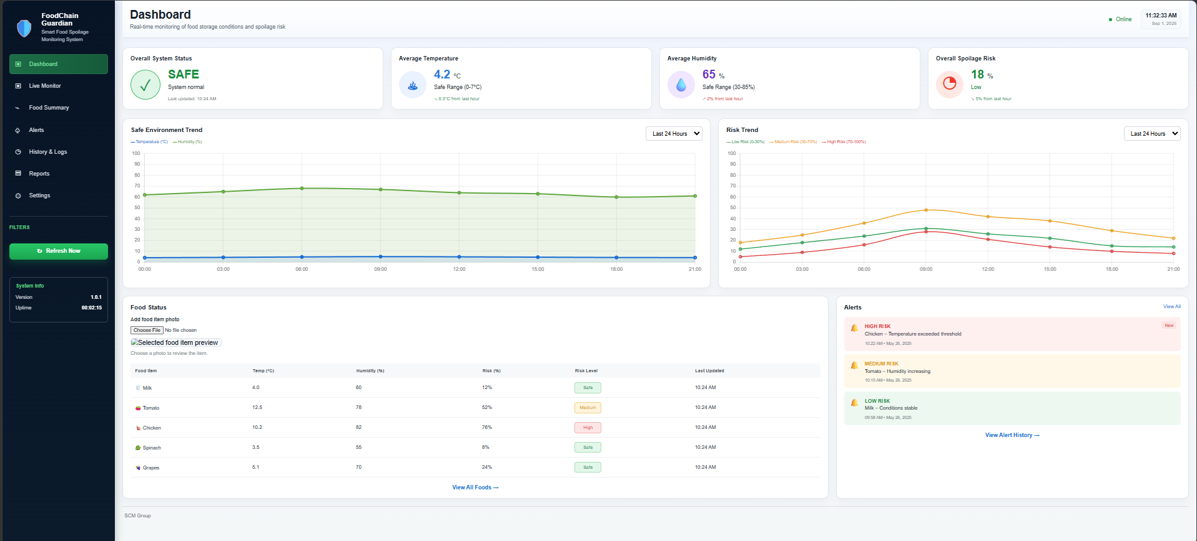
THE WORKING MODEL
INSERT PHOTO / SCREENSHOT HERE
e.g. the live dashboard, a terminal run, or the team demoing the working model
11

Slide 12
SEEING IT WORK
Real output from node demo.js — 18 items run through the full pipeline.
$ node demo.js
[chicken] Temp: 9.2°C Humidity: 88% → HIGH RISK
⚠ Alert dispatched: email + SMS
[salmon] Temp: 8.6°C Humidity: 91% → HIGH RISK
⚠ Alert dispatched: email + SMS
[lettuce] Temp: 12.1°C Humidity: 95% → HIGH RISK
⚠ Alert dispatched: email + SMS
[apple] Temp: 4.1°C Humidity: 60% → SAFE
[bread] Temp: 21.0°C Humidity: 45% → MEDIUM RISK
18 items processed — 5 High / 4 Medium / 9 Safe
From the real 18-item demo dataset used in Member 4's test suite.
12

Slide 13
WHAT WE ACHIEVED
1
Full Pipeline Integrated
4 Modules
2
Proper SCM Practice
100+ Commits
Sensor simulation → risk engine → database → dashboard → alerts, all working end to end.
Feature branches, pull requests, and code review before every merge across the team.
3
Verified & Tested
Passed all tests
4
Real-Time Alerting
0 Duplicate Alerts
Automated test suite covering core logic on the alerts/database module.
High-risk conditions trigger Email and SMS notifications automatically, with duplicate prevention.
13

Slide 14
THANK YOU
Questions?
14

